Slide 1
Module 8.3 Routing Security
ARP, OSPF, BGP

Slide 2
Interdomain Routing
(AS#32)
Stanford.edu
BGP
earthlink.net
(AS#4355)
Autonomous System
OSPF
connected group of one or more Internet Protocol prefixes under a single routing policy (aka domain)
Notes:
OSPF: open shortest path first

Slide 3
Routing Protocols
ARP (addr resolution protocol): IP addr ⟶ eth addr Security issues: (local network attacks)
Node A can confuse gateway into sending it traffic for Node B
By proxying traffic, node A can read/inject packets into B’s session (e.g. WiFi networks)
OSPF: used for routing within an AS
BGP: routing between Autonomous Systems Security issues: unauthenticated route updates
Anyone can cause entire Internet to send traffic for a victim IP to attacker’s address
Example: Youtube-Pakistan mishap (see DDoS lecture)
Anyone can hijack route to victim (next slides)
Notes:
OSPF: open shortest path first

Slide 4
BGP example [D. Wetherall]
1
3
3 2 7
4
2 7
2 6 5
2 6 5
3 2 6 5
5
8
2
2 7
6 5
7 2 6 5
7
2 7
6
6 2 7
5
7
7
2 6 5
5

Slide 5
Security Issues
BGP path attestations are un-authenticated
Anyone can inject advertisements for arbitrary routes
Advertisement will propagate everywhere
Used for DoS, spam, and eavesdropping
Often a result of human error
Solutions:
RPKI: AS obtains a certificate (ROA) from RIR and attaches ROA to path advertisements. Advertisements without a valid ROA are ignored. Defends against a malicious AS (but not a network attacker)
ROA = Route Origination Authorization
RIR= Regional Internet Registry
SBGP: sign every hop of a path advertisement
Notes:
RIR: Regional Internet Registries (assign IP blocks to AS’s)
ROA: Route Origin Authorizations. Contains: AS number (ASN), validity date range, IP prefixes.
ROA says that an ASN is authorized to advertise for specific prefixes.

Slide 6
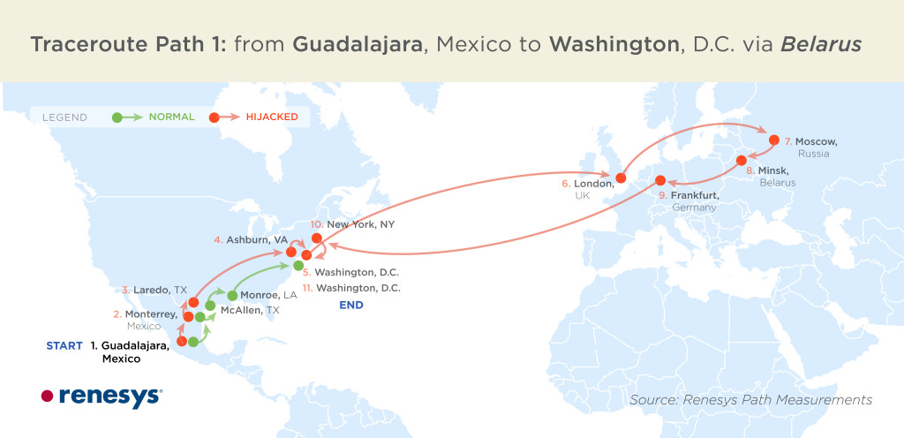
Example path hijack (source: Renesys 2013)
Feb 2013: Guadalajara ⟶ Washington DC via Belarus
route in effect
for several hours
Normally: Alestra (Mexico) ⟶ PCCW (Texas) ⟶ Qwest (DC)
Reverse route (DC ⟶ Guadalajara) is unaffected:
Person browsing the Web in DC cannot tell by traceroute that HTTP responses are routed through Moscow
Notes:
Path from DC to Guadalajara is unchanged. Only return path is changed.

Slide 7
OSPF: routing inside an AS
Link State Advertisements (LSA):
Flooded throughout AS so that all routers in the AS have a complete view of the AS topology
Transmission: IP datagrams, protocol = 89
Neighbor discovery:
Routers dynamically discover direct neighbors on attached links --- sets up an “adjacency”
Once setup, they exchange their LSA databases

Slide 8




Example: LSA from Ra and Rb
Ra LSA
Net-1
Rb LSA
Ra
Rb
R3
LSA DB:
Net-1
Net-1
Ra
Ra
Rb
2
2
Rb
3
1
1
3
1
Notes:
Ra and Rb send an LSA about the connection between them. That LSA is received by R3 and it updates its own LSA database.

Slide 9
Security features
OSPF message integrity (unlike BGP)
Every link can have its own shared secret
Unfortunately, OSPF uses an insecure MAC:
MAC(k,m) = MD5(data ll key ll pad ll len)
Every LSA is flooded throughout the AS
If a single malicious router, valid LSAs may still reach destination.
The “fight back” mechanism
If a router receives its own LSA with a newer timestamp than the latest it sent, it immediately floods a new LSA
Links must be advertised by both ends

Slide 10


Still some attacks possible [NKGB’12]
Threat model:
single malicious router wants to disrupt all AS traffic
Example problem: adjacency setup need no peer feedback
Victim (DR)
a remote attacker
adjacency
False Hello and DBD messages
phantom router
adjacency
LAN
adjacency
net 1
Result: DoS on net 1
Notes:
A router can setup an adjacency with a peer router without ever hearing back from the peer. Therefore, a remote attacker can cause a victim router to setup an adjacency with a phantom peer, resulting in DoS.

